Slide 1
Topic: Bearings
EQ: How do bearings relate to trigonometry?

Slide 2


LO: Trigonometry & Bearings
Bearings are ALWAYS given from the North, and can be anything from 0° to 360°
90° is usually given as due ….
East
180° is usually given as due…
South
270° is usually given as due…
West
Bearings always have 3 figures, so a 0 (or 2) is placed at the from of angles less than 100°
e.g 47° is given as 047°
2° is given as 002°
Keywords: angle, length, kilometres, bearing, distance

Slide 3
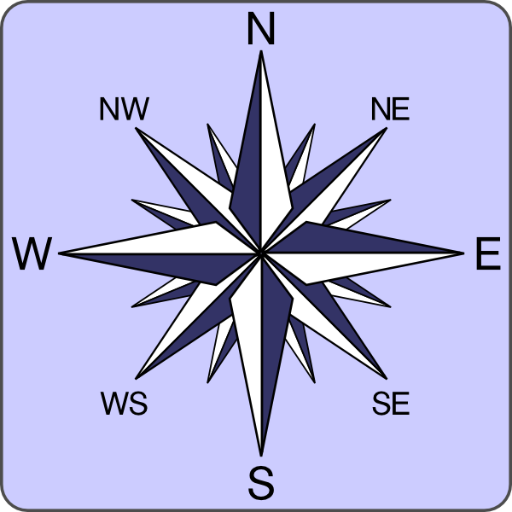

Compass
Bearing
Cardinal Points
NNW
NNE
Ordinal Points
WNW
ENE
Extra Points
WSW
ESE
Toggle Switches
SSW
SSE
Is ‘WS’ the same as ‘SW’?
A
Yes

Slide 4
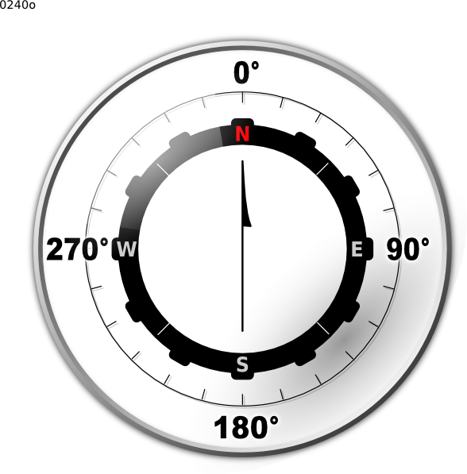
True Bearing
Always measured
from North.
In a clockwise
direction.
345º
030º
Press
300º
075º
105º
135º
210º
Eg
75º
135º
345º
300º
105º
30º
210º

Slide 5


Compass
Bearing
A
N
B
P
NNW
NNE
C
O
NW
NE
ENE
D
N
WNW
Press ctrl-A
then click on a letter
to see the Compass Bearing
E
W
M
E
F
WSW
L
ESE
SW
SE
G
K
H
J
SSW
SSE
S
I

Slide 6
Exercises
True Compass
N 0º
SW 225º
E 090º
NE 045º
e) NNE 022.5º
True Compass
f) NW 315º
g) S 180º
h) SE 135º
i) W 270º
j) ESE 112.5º

Slide 7
1
The beach(B) is on a bearing of 064° from the Airport (A), at a distance of 20km. How far east is the beach from the Airport?
B
064°
20km
A
Step 1
Draw your initial bearing
B
20km
064°
A
?

Slide 8
1
The beach(B) is on a bearing of 064° from the Airport (A), at a distance of 20km. How far east is the beach from the Airport?
The beach(B) is on a bearing of 064° from the Airport (A), at a distance of 20km. How far east is the beach from the Airport?
B
064°
20km
A
2
Step 2
B
20km
Complete the triangle
064°
A
?
B
20km
064°
A
?

Slide 9
1
The beach(B) is on a bearing of 064° from the Airport (A), at a distance of 20km. How far east is the beach from the Airport?
B
064°
20km
A
2
Step 3
B
20km
Use angle facts to find an angle in the triangle
064°
A
?
3
B
B
20km
064°
26°
A
?
20km
064°
A
26°
?

Slide 10
1
The beach(B) is on a bearing of 064° from the Airport (A), at a distance of 20km. How far east is the beach from the Airport?
B
064°
20km
A
Step 4
2
B
Label all relevant sides and choose correct trig ration
20km
064°
A
?
3
B
B
20km
Have Hyp
Want Adj
Use Cos ratio
064°
H
26°
A
O
?
20km
064°
4
B
H
O
26°
A
064°
20km
Have Hyp
Want Adj
Use Cos ratio
A
A
26°
?
A
?

Slide 11

1
The beach(B) is on a bearing of 064° from the Airport (A), at a distance of 20km. How far east is the beach from the Airport?
B
20km
064°
A
2
B
20km
064°
A
?
Cos26 = $\frac{A}{20km}$
A = Cos26 x 20km = 17.98km
3
B
20km
064°
26°
A
?
4
H
B
O
20km
064°
Got H
Want A
Use CAH
A
26°
A
?

Slide 12
The beach(B) is on a bearing of 064° from the Airport (A), at a distance of 20km. How far east is the beach from the Airport?
B
20km
064°
A
x

Slide 13
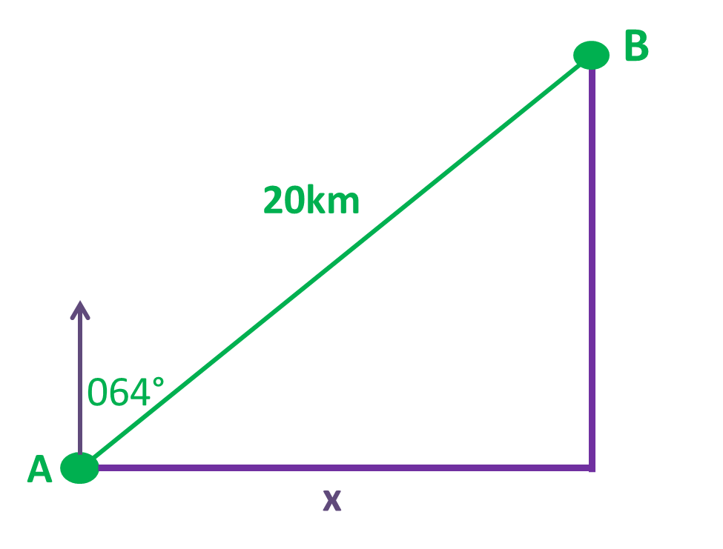

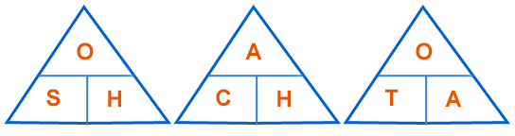




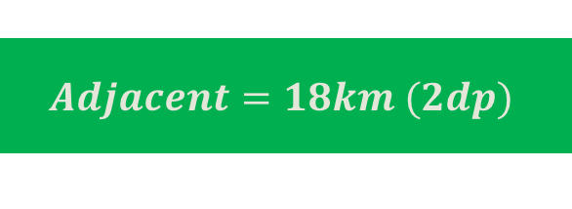


The beach(B) is on a bearing of 064° from the Airport (A), at a distance of 20km. How far east is the beach from the Airport?
$$Adjacent=cos\left(x\right)×hyp$$
26°
$$Adjacent=cos\left(26\right)×20$$
$$Adjacent=18km (2dp)$$
90 – 64 = 26⁰

Slide 14

A plane flies for 150km on a bearing of 099º.
North
099°
East
A
How far east has it travelled?
150km
9⁰

Slide 15
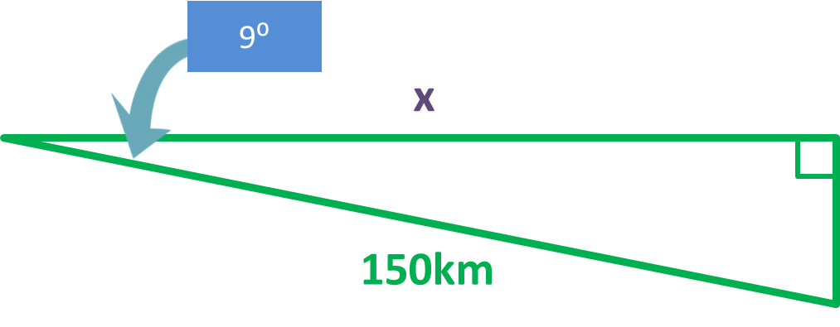
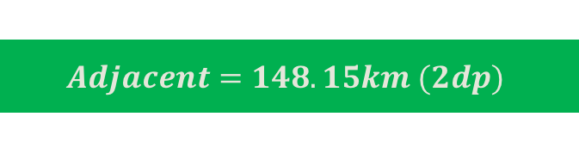


A plane flies for 150km on a bearing of 099º.
How far east has it travelled?
$$Adjacent=cos\left(x\right)×hyp$$
$$Adjacent=cos(9)×150$$
$$Adjacent=148.15km (2dp)$$

Slide 16
A ship sails on a bearing of 120° for 50 km. How far east has it travelled?
A ship sails on a bearing of 120° for 50 km.
How far east has it travelled?
Sketch your diagram
North
120°
East
A
30⁰
50km

Slide 17




Independent task
A ship sails on a bearing of 120° for 50 km. How far east has it travelled?
East
$$Adjacent=cos\left(x\right)×hyp$$
30⁰
50km
$$Adjacent=cos\left(30\right)×50$$
$$Adjacent=43.3km$$

Slide 18
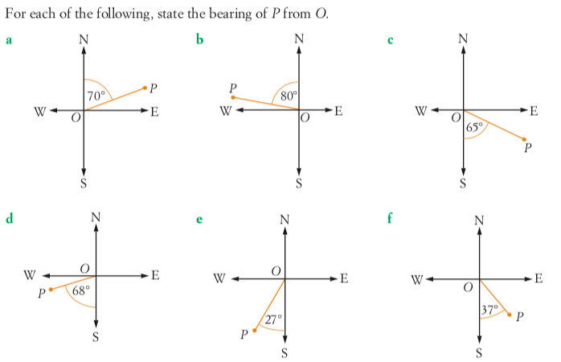

Slide 19


Slide 20
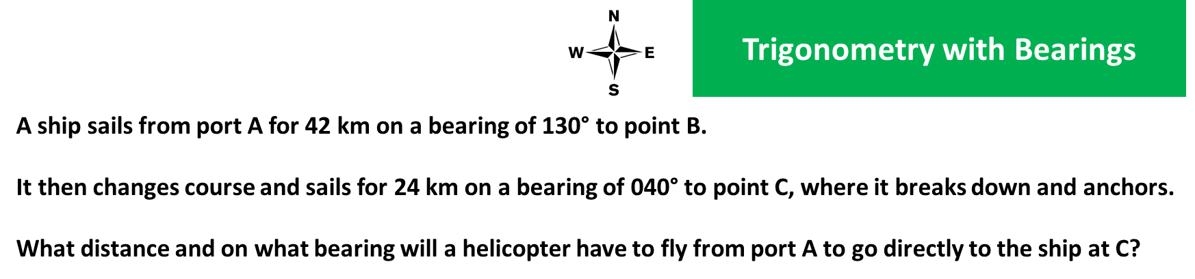
Some practice

Slide 21
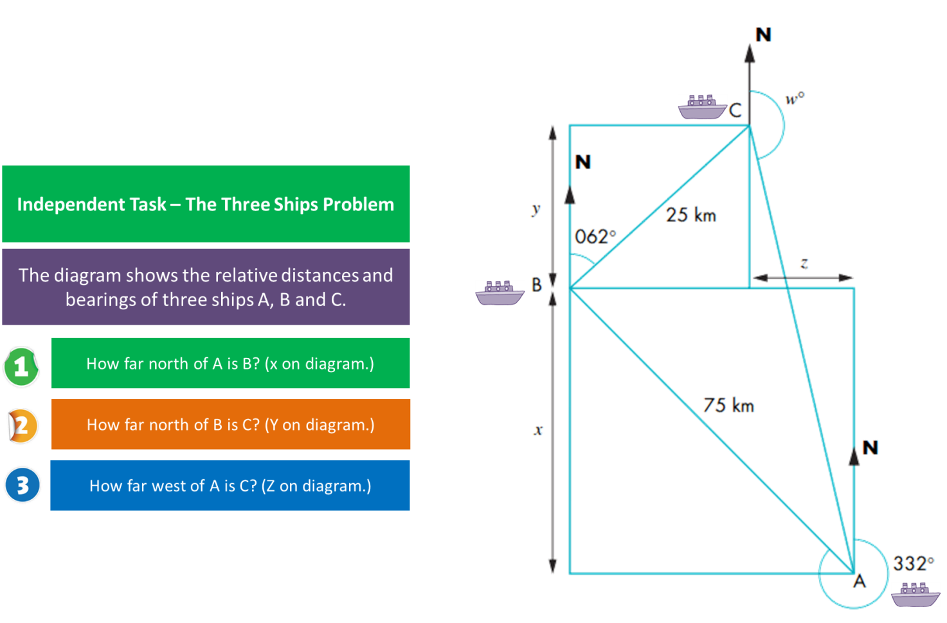
Some practice

Slide 22
Topic: Bearings EQ: How do bearings relate to trigonometry?
Complete Summary
Complete Angles of Elev and Bearings Worksheet
Summary:

